Slide 1

Vehicle Extrication and Special Rescue
CHAPTER 39

Slide 2
National EMS Education Standard Competencies
EMS Operations
Knowledge of operational roles and responsibilities to ensure patient, public, and personnel safety.
Vehicle Extrication
  Safe vehicle extrication
  Use of simple hand tools
Notes:
National EMS Education Standards Competencies
EMS Operations
Knowledge of operational roles and responsibilities to ensure patient, public, and personnel safety.
Vehicle Extrication
• Safe vehicle extrication
• Use of simple hand tools

Slide 3
Introduction
You will usually not be responsible for rescue and extrication.
  Rescue involves many different processes and environments.
  Requires training beyond the EMT level
Notes:
Lecture Outline
I. Introduction
A. You will usually not be responsible for rescue; you may assist with extrication.
1. Rescue requires training beyond the EMT level.

Slide 4
Safety
Extrication requires mental and physical preparation.
  Priority is to provide patient care.
  Consider the safety of yourself and team first.
  Equipment and gear should be appropriate to anticipated hazards.
Notes:
Lecture Outline
II. Safety
A. Extrication requires mental and physical preparation.
1. Priority is to provide patient care.
2. Personal safety and that of your team must be addressed before patient care is initiated.
3. The equipment that you use and the gear that you wear will depend on the hazards you expect to encounter, as well as what you observe during your scene size-up.

Slide 5
Vehicle Safety Systems (1 of 3)
Can become hazards after a collision
  Shock-absorbing bumpers may be “loaded” and can release and injure you.
  Approach vehicles from the side.
  Manufacturers are required to install airbags in all new cars.
  Airbags fill with a nonharmful gas on impact and quickly deflate.
Notes:
Lecture Outline
III. Vehicle Safety Systems
A. Vehicle safety systems can become hazards after a collision.
1. Shock-absorbing bumpers may be compressed or “loaded” following a front- or rear-end collision.
a. Approach vehicles from the side.
b. They can release and injure your knees and legs.
2. Manufacturers are required to install supplemental restraints or airbags in all new cars.
a. Airbags fill with a nonharmful gas on impact and quickly deflate after the crash.

Slide 6
Vehicle Safety Systems (2 of 3)
Airbags are located in the steering wheel and the dash in front of the passenger.
  Side-impact airbags may be located in the doors or seats.
  Airbags should be deployed and deflated by the time you arrive.
  Nondeployed airbags may spontaneously inflate while you provide patient care.
Notes:
Lecture Outline
b. Airbags are located in the steering wheel and the dash in front of the passenger.
i. Side-impact airbags may be located in the doors or seats.
c. Nondeployed airbags may spontaneously inflate while you provide patient care.
i. Maintain at least a 5-inch clearance around side-impact airbags that have not deployed.
ii. Maintain at least a 10-inch clearance around driver-side airbags that have not deployed.
iii. Maintain at least a 20-inch clearance around passenger-side airbags that have not deployed.

Slide 7
Vehicle Safety Systems (3 of 3)
  Haze inside vehicles in which the airbags have deployed is caused by cornstarch or talc.
  Use protective gear, including eye protection, to reduce the risk of eye or lung irritation from this substance.
Notes:
Lecture Outline
d. Haze inside vehicles in which the airbags have deployed is caused by cornstarch or talc.
e. Appropriate protective gear, including eye protection, will reduce the risk of eye or lung irritation from this substance.

Slide 8
Fundamentals of Extrication (1 of 3)
Your primary concern is safety.
Your primary roles are to:
  Provide emergency medical care.
  Prevent further injury to the patient.
You may provide care as extrication goes on around you.
Notes:
Lecture Outline
IV. Fundamentals of Extrication
A. Your primary concern is safety.
1. Your primary roles are to:
a. Provide emergency medical care.
b. Prevent further injury to the patient.
2. You may provide care as extrication goes on around you.

Slide 9
Fundamentals of Extrication (2 of 3)
Extrication is the removal from entrapment or a dangerous situation or position.
Entrapment is a condition in which a person is caught within a closed area with no way out or has a limb or other body part trapped.
Notes:
Lecture Outline
3. Extrication: the removal from entrapment or from a dangerous situation or position
4. Entrapment: a condition in which a person is caught within a closed area with no way out or has a limb or other body part trapped

Slide 10
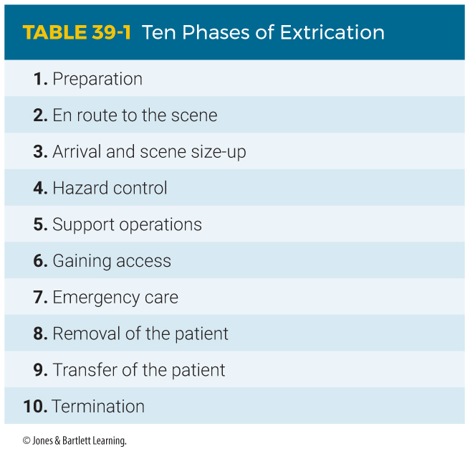
Fundamentals of Extrication (3 of 3)
Notes:
The table on this slide shows the 10 Phases of Extrication.

Slide 11
Roles and Responsibilities (1 of 4)
EMS personnel are responsible for:
  Assessing and providing medical care
  Triaging and packaging patients
  Providing additional assessment and care as needed once patients are removed
  Providing transport to the ED
Notes:
Lecture Outline
B. Roles and responsibilities
1. EMS providers are responsible for:
a. Assessing and providing medical care
b. Triaging and packaging patients
c. Providing additional assessment and care as needed once patients are removed
d. Providing transport to the emergency department

Slide 12
Roles and Responsibilities (2 of 4)
The rescue team is responsible for:
  Securing and stabilizing the vehicle
  Providing safe entrance and access to the patients
  Extricating any patients
Notes:
Lecture Outline
2. The rescue team is responsible for:
a. Securing and stabilizing the vehicle
b. Providing safe entrance and access to the patients
c. Extricating any patients

Slide 13
Roles and Responsibilities (3 of 4)
Law enforcement personnel are responsible for:
  Controlling traffic
  Maintaining order at the scene
  Establishing and maintaining a perimeter
Notes:
Lecture Outline
3. Law enforcement officers are responsible for:
a. Controlling traffic
b. Maintaining order at the scene
c. Establishing and maintaining a perimeter

Slide 14
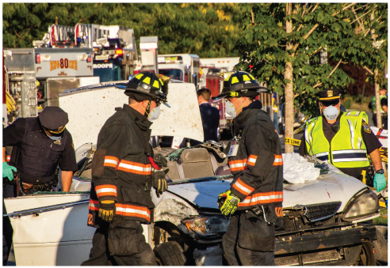
Roles and Responsibilities (4 of 4)
Firefighters are responsible for:
  Extinguishing fire
  Preventing additional ignition
  Ensuring scene safety
  Removing spilled fuel
FIGURE 39-2 EMS providers, the rescue team, law
enforcement officers, and firefighters have distinct
responsibilities at a rescue scene and must cooperate to
manage the incident.
© Brian Logan Photography/Shutterstock.
Notes:
Lecture Outline
4. Firefighters are responsible for:
a. Extinguishing fire
b. Preventing additional ignition
c. Ensuring that the scene is safe
d. Removing spilled fuel
5. Roles and responsibilities often vary based on jurisdiction and available agencies.
6. Good communication among team members and clear leadership are essential to safe, efficient provision of proper emergency care.

Slide 15
Preparation
Preparing for an incident requiring extrication involves preincident training with rescue personnel.
Rescue personnel must routinely check extrication tools and their response vehicles.
Notes:
Lecture Outline
C. Preparation
1. Preparing for an incident requiring extrication involves preincident training with rescue personnel for the various types of rescue situations to which you might respond.
2. Rescue personnel must routinely check the extrication tools and their response vehicles.

Slide 16
En Route to the Scene
Procedures and safety precautions similar to those in the phases of an ambulance call are used when responding to a rescue incident.
Notes:
Lecture Outline
D. En route to the scene
1. Procedures and safety precautions similar to those in the phases of an ambulance call are used when responding to a rescue incident.

Slide 17
Arrival and Scene Size-up (1 of 9)
Position the ambulance to block the scene from oncoming traffic.
  Use only essential warning lights.
  Choose a location that will allow safe access and exit.
Put on PPE and look for passing cars before exiting your vehicle.
Notes:
Lecture Outline
E. Arrival and scene size-up
1. Position the ambulance to block the scene from oncoming traffic.
a. Use only essential warning lights.
b. Choose a location that will allow safe access to the scene while leaving a way to drive your ambulance out.
2. Put on PPE and look for passing cars before exiting your vehicle.

Slide 18
Arrival and Scene Size-up (2 of 9)
Make sure the scene is properly marked and protected.
  Request assistance from law enforcement; they should ensure the road is closed.
  Your job is patient care, but you may need to direct traffic until other units arrive.
Size-up is the ongoing process of information gathering and scene evaluation.
Notes:
Lecture Outline
3. Make sure the scene is properly marked and protected.
4. Size-up is the ongoing process of information gathering and scene evaluation to determine appropriate strategies and tactics to manage an emergency.

Slide 19
Arrival and Scene Size-up (3 of 9)
During a 360° walk around, look for:
  Mechanism of injury
  Downed electrical lines
  Leaking fuels or fluids
Notes:
Lecture Outline
5. Evaluate the hazards and determine the number of patients by doing a 360° walk around of the scene.
a. Look for the following:
i. Mechanism of injury
ii. Downed electrical lines
iii. Leaking fuels or fluids

Slide 20
Arrival and Scene Size-up (4 of 9)
During a 360° walk around, look for: (cont’d)
  Smoke or fire
  Broken glass
  Trapped or ejected patients
  The number of patients and vehicles involved
Notes:
Lecture Outline
iv. Smoke or fire
v. Broken glass
vi. Trapped or ejected patients
vii. The number of patients and vehicles involved

Slide 21
Arrival and Scene Size-up (5 of 9)
While looking at the vehicle, note damage.
  Bent steering wheel may indicate significant face and/or thoracic trauma.
  Imprints in the dashboard may indicate lower extremity injuries.
  Lift deployed airbags to see if there is deformity to the steering wheel or dashboard, which may indicate the patient struck the structure after the airbag deflated.
Notes:
Lecture Outline
b. While looking at the vehicle(s) involved in a motor vehicle collision, note the damage to the vehicle(s).
i. Bent steering wheel may indicate significant face and/or thoracic trauma.
ii. Imprints in the dashboard may indicate lower extremity injuries such as fractures and possible hip dislocations and fractures.
iii. Lift deployed airbags to see if there is deformity to the steering wheel or dashboard, which indicates the patient struck the structure after the airbag deflated.

Slide 22
Arrival and Scene Size-up (6 of 9)
Note damage to vehicle (cont’d)
  Unrestrained patients may have contact injuries as well as secondary injuries.
  Check windshield for a spider-web pattern of shattered glass, indicating possible head, face, or neck injuries.
  Include findings in your documentation.
  Use the information to maintain a high index of suspicion.
Notes:
Lecture Outline
iv. Unrestrained patients may have contact injuries as well as secondary injuries; check windshield for a spider-web pattern of shattered glass indicating possible head, face, or neck injuries.
v. Include findings in your documentation; use the information to maintain a high index of suspicion.

Slide 23
Arrival and Scene Size-up (7 of 9)
Evaluate the need for additional resources, such as:
  Extrication equipment
  Fire department
  Law enforcement
  Hazmat unit
  Utility company
  Advanced life support units
  Air transport
Notes:
Lecture Outline
c. Evaluate the need for additional resources

Slide 24
Arrival and Scene Size-up (8 of 9)
Other potential hazards
  Look for spilled fuel and other flammables.
  Electrical short or damaged battery
  Rain, sleet, snow
  Crashes that occur on hills
  Violence
Notes:
Lecture Outline
d. Look for spilled fuel and other flammable substances.
e. Rain, sleet, or snow can present an added hazard for rescue.
f. Crashes that occur on hills are harder to handle than those that occur on level ground.
g. Some crash scenes may present threats of violence.

Slide 25
Arrival and Scene Size-up (9 of 9)
Coordinate your efforts with rescue teams and law enforcement.
  Communicate with the rescue team.
  Start talking to the incident commander as soon as you arrive.
  You become a member of the rescue team.
Notes:
Lecture Outline
6. Coordinate your efforts with rescue teams and law enforcement.
a. Communicate with members of the rescue team throughout extrication.
i. Start talking to the incident commander as soon as you arrive.
ii. You will enter the vehicle and provide care for the patient(s) when approved by the incident commander.

Slide 26
Hazard Control (1 of 5)
Downed electrical lines are a common hazard at vehicle crash scenes.
  Never attempt to move them.
  Instruct the patient to remain in the vehicle until power is shut off.
  Remain in the safe zone, outside of the danger zone (hot zone).
Notes:
Lecture Outline
F. Hazard control
1. Downed electrical lines are a common hazard at vehicle crash scenes.
a. Never attempt to move downed electrical lines.
b. If power lines are close to a vehicle involved in a crash, instruct the patient to remain in the vehicle until power is shut off.
c. Remain in the safe zone, outside of the danger zone (hot zone).

Slide 27
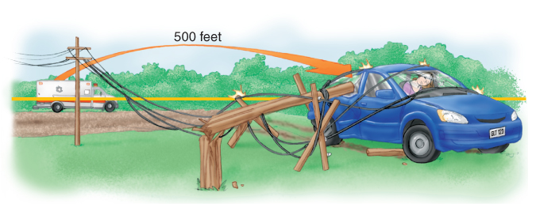
Hazard Control (2 of 5)
FIGURE 39-4 Remain outside the danger zone (hot zone).
© Jones & Bartlett Learning.
Notes:
The illustration on this slide displays the danger zone (hot zone).

Slide 28
Hazard Control (3 of 5)
Family members and bystanders can also create hazards.
The vehicle can also be a hazard.
  Automobile on its side or roof can be a danger.
  Rescue personnel can stabilize the car.
  Ensure that the car is in “park” with the parking brake set and the ignition turned off.
  Both battery cables should be disconnected to minimize the possibility of sparks or fire.
Notes:
Lecture Outline
2. Family members and bystanders can also create hazards.
3. The vehicle also can be a hazard.
a. An unstable automobile on its side or roof can be a danger to you.
i. Rescue personnel can stabilize the car with a variety of jacks or cribbing.
b. Ensure that the car is in “park” with the parking brake set and the ignition turned off.
c. Both battery cables should be disconnected to minimize the possibility of sparks or fire.

Slide 29
Hazard Control (4 of 5)
Alternative fuel vehicles
  Powered by electricity and electricity/gasoline hybrids, or fuels such as propane, natural gas, methanol, or hydrogen.
  Disconnect the battery in all cases.
  Batteries may be in the trunk or under the seats.
  May be more than one battery
Notes:
Lecture Outline
4. Alternative fuel vehicles
a. Vehicles may be powered by electricity and electricity/gasoline hybrids, or fuels such as propane, natural gas, methanol, or hydrogen.
i. Disconnect the battery to prevent further fire or explosion.
ii. In more than 40% of today’s alternative fuel vehicles, the batteries are located in the trunk or under the seats, not in the engine compartment.
iii. There may be more than one battery present.

Slide 30
Hazard Control (5 of 5)
Hybrid vehicle systems
  Have batteries with a higher voltage
  May take up to 10 minutes to deenergize after the main battery is turned off
  Avoid high-voltage cables (typically orange) and components.
  Damaged high-voltage batteries may give off toxic fumes.
  Do not approach the vehicle if unusual odor is detected.
  Retreat if you experience burning in eyes or throat.
Notes:
Lecture Outline
b. Hybrid vehicle systems
i. Hybrid batteries have a higher voltage than traditional automotive batteries.
ii. It may take up to 10 minutes for a high voltage system to deenergize after the main battery is turned off.
iii. Avoid high-voltage cables (typically orange) and components.
iv. Damaged high-voltage batteries may give off toxic fumes.
v. Do not approach the vehicle if unusual odor is detected, and retreat if you experience burning in your eyes or throat.

Slide 31
Support Operations
Support operations include:
  Lighting the scene
  Establishing tool and equipment staging areas
  Marking helicopter landing zones
Fire and rescue personnel will work together on these functions.
Notes:
Lecture Outline
G. Support operations
1. Support operations include:
a. Lighting the scene
b. Establishing tool and equipment staging areas
c. Marking helicopter landing zones
2. Fire and rescue personnel will work together on these functions.

Slide 32
Gaining Access (1 of 9)
Critical phase of extrication
  Make sure that the vehicle is stable and hazards are eliminated or controlled.
Exact way to gain access depends on the situation
  Identify safest, most efficient way to gain access.
  If there are multiple patients, locate and rapidly triage each patient.
Notes:
Lecture Outline
H. Gaining access
1. Gaining access to the patient is a critical phase of extrication.
a. Make sure that the vehicle is stable and hazards are eliminated or controlled.
2. The exact way to gain access to a patient depends on the situation.

Slide 33
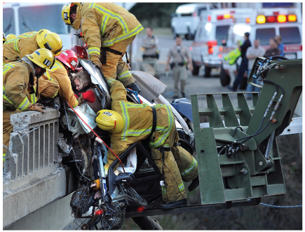
Gaining Access (2 of 9)
FIGURE 39-6 The exact way to gain access depends on many factors, including the terrain, the way in which the vehicle is situated, and the weather.
© ZUMA Press Inc/Alamy Stock Photo.
Notes:
The figure on this slide shows a motor vehicle collision. The exact way to gain access depends on many factors, including the terrain, the way in which the vehicle is situated, and the weather.

Slide 34
Gaining Access (3 of 9)
To determine the exact location and position of the patient, consider:
  Is the patient in a vehicle or in some other structure?
  Is the vehicle or structure damaged?
  What hazards exist that pose a risk?
  In what position is the vehicle? On what type of surface? Is it apt to roll or tip?
Notes:
Lecture Outline
3. To determine the exact location and position of the patient, consider the following questions:
a. Is the patient in a vehicle or in some other structure?
b. Is the vehicle or structure severely damaged?
c. What hazards exist that pose a risk to the patient and rescuers?
d. In what position is the vehicle? On what type of surface? Is the vehicle stable or is it apt to roll or tip?

Slide 35
Gaining Access (4 of 9)
As patients’ conditions change, you may have to change your course of action.
Rapid vehicle extrication may be needed to quickly remove a patient if the environment is threatening or if the patient needs CPR.
  A team of experienced EMTs should be able to perform rapid extrication in 1 minute or less.
Notes:
Lecture Outline
4. Rapid vehicle extrication may be needed to quickly remove a patient if the environment is threatening or if the patient needs cardiopulmonary resuscitation.
a. A team of experienced EMTs should be able to perform rapid extrication in 1 minute or less.

Slide 36
Gaining Access (5 of 9)
Keep the patient safe.
  A heavy, fire-resistant blanket can protect from breaking glass, flying particles, tools, or other hazards.
  A long backboard may be used as a shield.
  Talk to the patient, and explain your steps.
  Keep heat, noise, and force to a minimum.
Notes:
Lecture Outline
5. During the access and extrication phases, make sure the patient remains safe.
a. A heavy, fire-resistant blanket can be used to protect the patient from breaking glass, flying particles, tools, or other hazards.
b. Always describe what you are going to do before you do it and as you are doing it, even if you think the patient is unresponsive.
c. Try to keep heat, noise, and force to a minimum.

Slide 37
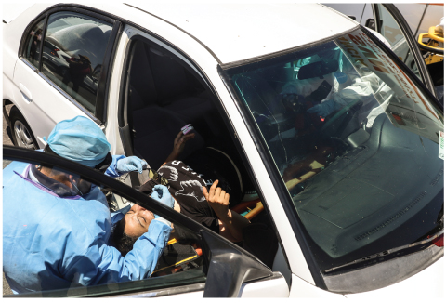
Gaining Access (6 of 9)
FIGURE 39-7 Always explain to the patient why you are
there and what you are doing.
© Norte Photo/Getty Images News/Getty Images.
Notes:
The figure on this slide shows an EMS provider accessing the patient. Always explain to the patient why you are there and what you are doing.

Slide 38
Gaining Access (7 of 9)
Simple access
  Trying to access the patient as quickly and simply as possible without using tools or breaking glass
  Cars are built for easy entry and exit.
  The rescue team should provide access.
  If the rescue team has not yet arrived, use tools available on the ambulance.
  Use all door handles or roll down the windows before using other methods.
Notes:
Lecture Outline
7. Simple access
a. Your first step is simple access, trying to get to the patient as quickly and simply as possible without using any tools or breaking any glass.
b. Automobiles are built for easy entry and exit.
i. It may be necessary to use forcible entry methods.
c. The rescue team should provide the entrance you need to gain access to the patient.
d. If the rescue team has not yet arrived, use tools like hammers, center punches, pry bars, and hacksaws.
i. Available on the ambulance
e. Gain access by trying to use all door handles or by rolling down the windows before breaking any windows or using other methods of forced entry.

Slide 39
Gaining Access (8 of 9)
Complex access
  Requires special tools, such as hand, pneumatic, and hydraulic devices
  Requires special training
  Includes breaking windows or removing roof
These advanced skills are typically performed by a specialized team.
Notes:
Lecture Outline
8. Complex access
a. Complex access requires special tools, such as pneumatic and hydraulic devices.
i. Requires special training
ii. Includes breaking windows or removing roof
b. These advanced skills are typically performed by a specialized team.

Slide 40
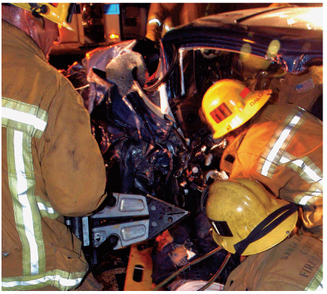
Gaining Access (9 of 9)
FIGURE 39-9 Complex access often requires the use of pneumatic and/or hydraulic devices.
© Keith D. Cullom.
Notes:
The figure on this slide shows the extrication process. Complex access requires the use of pneumatic and/or hydraulic devices.

Slide 41
Emergency Care
Perform a primary assessment and provide care before further extrication:
  Control any exsanguinating hemorrhage.
  Provide manual stabilization to the spine.
  Open the airway.
  Provide high-flow oxygen.
  Assist or provide for adequate ventilation.
  Control any significant external bleeding.
  Treat all critical injuries.
Notes:
Lecture Outline
I. Emergency care
1. Providing medical care to a patient who is trapped in a vehicle is essentially the same as for any other patient.
2. Once entrance and access to the patient have been provided and the scene is safe, perform a primary assessment and provide care before further extrication begins.
a. Address any exsanguinating hemorrhage with direct pressure or a tourniquet if appropriate.
b. Provide manual stabilization to protect the cervical spine, as needed.
c. Open the airway.
d. Provide high-flow oxygen.
e. Assist or provide for adequate ventilation.
f. Control any significant external bleeding.
g. Treat all critical injuries.

Slide 42
Removal of the Patient (1 of 4)
Coordinate with rescue personnel to determine the best removal route.
  Multistep process that is intensive in terms of the number of rescue personnel involved, the equipment used, and the effort required to prevent further injury or harm
Notes:
Lecture Outline
J. Removal of the patient
1. Rescue personnel should coordinate with you to determine the best removal route.

Slide 43
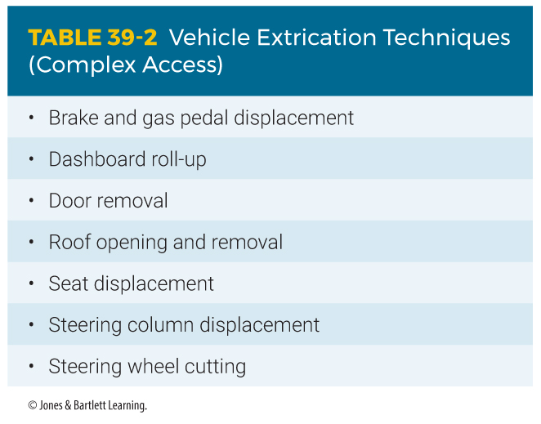
Removal of the Patient (2 of 4)
Notes:
The table on this slide lists vehicle extrication techniques (complex access).

Slide 44
Removal of the Patient (3 of 4)
You should participate in the preparation for patient removal.
  Determine the urgency of extrication.
  Determine the position to best protect the patient.
  Determine how you will move the patient to the backboard and then the stretcher.
  Determine the extent of the injuries.
Notes:
Lecture Outline
2. You should participate in the preparation for patient removal.
a. Determine how urgently the patient must be extricated.
b. Determine where you should be positioned to best protect the patient.
c. After the patient has been extricated, determine how you will move the patient to the backboard and then to the stretcher.
d. Your input is essential to so that the rescue team plans an extrication that protects the patient from further harm.
i. Reevaluate whether the patient needs rapid extrication

Slide 45
Removal of the Patient (4 of 4)
Your input is essential so that the rescue team plans an extrication that protects the patient from further harm.
Often you will be placed in the vehicle alongside the patient.
Notes:
Lecture Outline
3. Often you will be placed in the vehicle alongside the patient.
a. Be sure to wear proper protective equipment.

Slide 46
Transfer of the Patient (1 of 3)
Perform a complete primary assessment once the patient is free.
  Make certain that the spine is manually stabilized.
  Apply a cervical collar if not already done.
Move the patient in a series of smooth, slow, controlled steps with designated stops.
Notes:
Lecture Outline
K. Transfer of the patient
1. Perform a complete primary assessment once the patient has been freed.
a. Make certain that the spine is manually stabilized.
2. Move the patient in a series of smooth, slow, controlled steps, with designated stops to allow for repositioning and adjustments.

Slide 47
Transfer of the Patient (2 of 3)
One person should be in charge.
  Choose a path that requires the least manipulation.
  Ensure that everyone understands the steps and is ready.
  Move only on the team leader’s command.
  Move the patient as a unit.
  Continue to protect the patient from any hazards.
Notes:
Lecture Outline
b. One person should be in charge of the move.
i. Choose a path that requires the least manipulation of the patient and equipment.
ii. Ensure that everyone understands the steps and is ready.
iii. Move only on the team leader’s command.
iv. Move the patient as a unit.
v. Continue to protect the patient from any hazards.
Once the patient has been placed on the stretcher, continue with any additional assessment and treatment that was deferred.
4. Move only on the team leader’s command and move the patient as a unit.

Slide 48
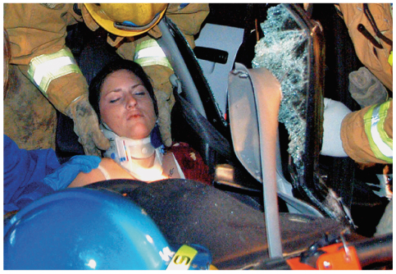
Transfer of the Patient (3 of 3)
FIGURE 39-10 Once the patient has been accessed,
rapidly assess the patient and make sure that the spine is manually stabilized. Apply a cervical collar if this was not previously done.
© Keith D. Cullom.
Notes:
The figure on this slide shows the management of a patient during the extrication process. Once the patient has been accessed, rapidly assess the patient, stabilize the spine is manually, and apply a cervical collar if not done previously.

Slide 49
Termination
Termination involves returning emergency units to service.
  All equipment used on the scene must be checked.
  Check and clean the ambulance, replacing used supplies.
  Complete all necessary reports.
Notes:
Lecture Outline
L. Termination
1. Termination involves returning emergency units to service.
a. All equipment used on the scene must be checked before reloading them on the apparatus.
b. Check and clean the ambulance thoroughly, replacing used supplies.
c. Rescue and medical units are required to complete all necessary reports.

Slide 50
Specialized Rescue Situations (1 of 3)
Sometimes a patient can be reached only by special teams.
Specialized team skills include:
  Cave rescue
  Confined space rescue
  Cross-field and trail rescue (park rangers)
  Dive rescue
Notes:
Lecture Outline
V. Specialized Rescue Situations
A. Sometimes a patient can be reached only by teams trained in special technical rescues.
1. Specialized skills of these teams include the following:
a. Cave rescue
b. Confined space rescue
c. Cross-field and trail rescue (park rangers)
d. Dive rescue

Slide 51
Specialized Rescue Situations (2 of 3)
Specialized team skills include: (cont’d)
  Missing person search and rescue
  Mine rescue
  Mountain-, rock-, and ice-climbing rescue
  Ski slope and cross-country or trail snow rescue
  Structural collapse rescue
Notes:
Lecture Outline
e. Missing person search and rescue
f. Mine rescue
g. Mountain-, rock-, and ice-climbing rescue
h. Ski slope and cross-country or trail snow rescue (ski patrol)
i. Structural collapse rescue

Slide 52
Specialized Rescue Situations (3 of 3)
Specialized team skills include: (cont’d)
  Special weapons and tactics (SWAT) team
  Technical rope rescue (low- and high-angle rescue)
  Trench rescue
  Water and small craft rescue
  White water rescue
Notes:
Lecture Outline
j. Special weapons and tactics (SWAT) team
k. Technical rope rescue (low- and high-angle rescue)
l. Trench rescue
m. Water and small craft rescue
n. White water rescue

Slide 53
Technical Rescue Situations (1 of 3)
Personnel need special technical skills and equipment.
  Not safe to include untrained personnel
A rescue group is trained and on call for certain types of technical rescues.
  Made up of individuals from one or more departments
  Many members are also trained as EMTs.
Notes:
Lecture Outline
B. Technical rescue situations
1. A technical rescue situation requires specialized skills and equipment to safely enter and move around.
a. It is not safe to include personnel who have not been trained.
2. Many members of technical rescue groups are also trained as emergency medical responders (EMRs) or EMTs.

Slide 54
Technical Rescue Situations (2 of 3)
Check with the incident commander to see if the technical rescue group has been summoned.
  The incident commander has overall command of the scene in the field.
  One member must clearly be in charge.
  A lack of identifiable leadership hinders rescue efforts.
  If no incident commander is present, follow local guidelines.
Notes:
Lecture Outline
3. Ensure the technical rescue team has been summoned and is en route.

Slide 55
Technical Rescue Situations (3 of 3)
When you arrive, you will be directed or led to the staging area.
  Take a long backboard and/or a basket stretcher, jump kits, and other equipment.
  Set up your equipment at the staging area.
  Perform a primary assessment as soon as the rescue team brings the patient to you.
  Packaging and carrying the patient back to the ambulance requires a joint effort.
Notes:
Lecture Outline
4. When you arrive at a technical rescue scene, you will be directed or led to the staging area.
a. Set up your equipment at the staging area, a stable location where you will be able to treat the patient.
b. Perform a primary assessment as soon as the rescue team brings the patient to you.
c. Packaging and carrying the patient back to the ambulance requires a joint effort between EMTs and the technical rescue team.

Slide 56
Search and Rescue (1 of 3)
An ambulance is usually summoned to the command post when a person is lost outdoors and a search effort is initiated.
  Your role is to stand by at the command post until the missing person or persons are found.
  Once you are briefed on the situation, isolate and prepare the equipment you may need.
  Leave the prepared equipment in the back of the ambulance to protect it from the weather.
Notes:
Lecture Outline
C. Search and rescue
1. An ambulance is usually summoned to the incident command post when a person is lost outdoors and a search effort is initiated.
a. Your role is to stand by at the command post until the missing person or persons have been found.

Slide 57
Search and Rescue (2 of 3)
You may be asked to stay with the family of the lost individual.
  Gather medical history and communicate to those in charge.
  Only the incident commander should communicate any news or progress to the family.
  Set your radio at a discreet volume.
Notes:
Lecture Outline
2. You may be asked to stay with family members of the lost individual.
a. Gather any medical history and communicate to those in charge.
b. Only the incident commander should communicate any news or progress of the search to the family.
i. Set your radio at a discreet volume.

Slide 58
Search and Rescue (3 of 3)
Once the missing person is found, you will be guided by search personnel to the location where you can begin treatment.
  You may need to relocate the ambulance or use an all-terrain vehicle.
  Ensure that the equipment is evenly distributed among providers.
  Ensure a pace is maintained such that all can stay together easily.
Notes:
Lecture Outline
3. Once the missing person is found, you will be guided by search personnel to the location where you can begin treatment.
a. Time and effort can sometimes be decreased by relocating the ambulance or by using an all-terrain vehicle.

Slide 59
Trench Rescue (1 of 4)
Many cave-ins and trench collapses have poor outcomes for victims.
  Collapses usually involve large areas of falling dirt that weigh approximately 100 lb per cubic foot.
  Victims cannot fully expand their lungs and may become hypoxic.
Notes:
Lecture Outline
D. Trench rescue
1. Many cave-ins and trench collapses have poor outcomes for victims.
a. Collapses usually involve large areas of falling dirt that weigh approximately 100 lb per cubic foot.
b. Victims with thousands of pounds of dirt on their chests cannot fully expand their lungs and may become hypoxic.

Slide 60
Trench Rescue (2 of 4)
Risk of secondary collapse is a concern.
  Safety measures can reduce the potential for injury.
Park response vehicles at least 500 feet from the scene.
  All vehicles should be turned off.
  Road traffic should be diverted from the 500-foot area.
Notes:
Lecture Outline
2. The risk of a secondary collapse is a concern to rescue personnel and EMTs.
a. Response vehicles should be parked at least 500 feet from the scene.
b. All vehicles should be turned off to avoid a secondary collapse caused by vibration.
c. All road traffic should be diverted from the 500-foot safety area.
d. Construction equipment at the collapse site may be unstable and could fall into the cave-in or trench site.

Slide 61
Trench Rescue (3 of 4)
Other hazards include downed electrical wires and broken glass or water lines.
  Construction equipment may be unstable and could fall into the cave-in or trench.
Witnesses to the incident should be identified.
  May be valuable in providing information
Notes:
Lecture Outline
3. At no time should medical or rescue personnel enter a trench without proper shoring in place.

Slide 62
Trench Rescue (4 of 4)
Assist nontrapped individuals from the area.
Do not enter a trench deeper than 4 feet without proper shoring in place.
During extrication of survivors, medical personnel trained in cave-in and trench collapse will provide most medical care.
  Be prepared to receive patients after extrication.
Notes:
Lecture Outline
4. During the extrication of any survivors, medical personnel trained in cave-in and trench collapse rescue will provide most medical care.
a. You should be prepared to receive patients once they have been extricated from the site.

Slide 63
Tactical Emergency Medical Support (1 of 3)
Law enforcement officers usually ensure scene safety.
  Sometimes a special weapons and tactics (SWAT) team is needed to secure an area.
    Hostage incidents
    Barricaded subjects
    Snipers
  Many communities have incorporated specially trained EMTs, paramedics, nurses, and physicians into police SWAT units.
Notes:
Lecture Outline
E. Tactical emergency medical support
1. A steady increase in violence throughout the country has resulted in EMTs taking precautions to ensure personal safety.
2. When the potential for violence exists, responding units should wait until the scene is secured by law enforcement officers.
a. Sometimes a special weapons and tactics (SWAT) team is needed to secure an area.
b. Many communities have incorporated specially trained EMTs, paramedics, nurses, and even physicians into police SWAT units.

Slide 64
Tactical Emergency Medical Support (2 of 3)
When called to the scene, determine the location of the command post and report to the incident commander.
  Lights and siren should be turned off.
  The command post is usually located in an area that cannot be seen by the suspect and is out of range of possible gunfire.
  Remain in this area.
Notes:
Lecture Outline
3. When called to the scene of a law enforcement tactical situation, determine the location of the command post and report to the incident commander for instructions.
a. Lights and siren should be turned off, and outside radio speakers should not be used when nearing the scene.
b. The command post is usually located in an area that cannot be seen by the suspect and is out of range of possible gunfire.
i. Remain in this area.

Slide 65
Tactical Emergency Medical Support (3 of 3)
Planning measures are key.
  Have the incident commander identify the specific location of the incident.
  The incident commander should determine a safe location to meet up with the SWAT team if an injury occurs.
  Designate helicopter landing zones.
  Identify the quickest route to the closest hospital, burn center, or trauma center.
Notes:
Lecture Outline
c. Planning measures are key in these situations.

Slide 66
Structure Fires (1 of 2)
In most areas, an ambulance is dispatched with the fire department apparatus.
Ask the incident commander where the ambulance should be staged.
Determine if there are any injured patients or if you have been called to stand by.
Notes:
Lecture Outline
F. Structure fires
1. In most areas, an ambulance is dispatched with the fire department to any structure fire.
a. Ask the incident commander where the ambulance should be staged.
b. Determine if there are any injured patients or whether you have been called to stand by.

Slide 67
Structure Fires (2 of 2)
Search and rescue in a burning building requires special training and equipment.
Sometimes a scene may be further complicated by hazardous materials.
Notes:
Lecture Outline
2. Search and rescue in a burning building requires special training and equipment.
a. Operations are performed by teams of firefighters wearing full turnout gear and self-contained breathing apparatus (SCBA).
3. Sometimes a scene may be further complicated by the presence of hazardous materials.

Slide 68
Review
Proper protective equipment will vary depending on the hazards encountered. Which piece of equipment should be utilized during all patient contacts?
  Turnout gear
  Helmets
  Blood- and fluid-impermeable gloves
  Goggles

Slide 69
Review
Answer: C
Rationale: The importance of wearing blood- and fluid-impermeable gloves at all times during patient contact cannot be emphasized enough. If you are involved with extrication, you should wear a pair of leather gloves over your disposable gloves.

Slide 70
Review
Proper protective equipment will vary depending on the hazards encountered. Which piece of equipment should be utilized during all patient contacts?
  Turnout gear
  Rationale: This equipment is important, but not necessary for every patient encounter.
  Helmets
  Rationale: This equipment is important, but not necessary for every patient encounter.
  Blood- and fluid-impermeable gloves
  Rationale: Correct answer
  Goggles
  Rationale: This equipment is important, but not necessary for every patient encounter.

Slide 71
Review
What is the first phase of extrication?
  Arrival
  Preparation
  Scene size-up
  Gaining access

Slide 72
Review
Answer: B
Rationale: There are 10 phases of extrication; preparation is the first. Preparing for an incident requiring extrication involves training for the various types of rescue situations your team might face. Just as you must check the equipment on the ambulance, rescue personnel must routinely check the extrication tools and their response vehicle to ensure proper operation. Preparation reduces the possibility of equipment failure at a scene.

Slide 73
Review
What is the first phase of extrication?
  Arrival
  Rationale: This is part of the third phase of extrication.
  Preparation
  Rationale: Correct answer
  Scene size-up
  Rationale: This is part of the third phase of extrication.
  Gaining access
  Rationale: This is the sixth phase of extrication.

Slide 74
Review
As you approach an unconscious patient who is still in her wrecked vehicle, you note that there is a power line entangled in the wreckage of the vehicle. You should:
  retreat until the power line has been removed or the power is shut off.
  carefully gain access to the patient without touching any metal objects.
  don a pair of rubber gloves and carefully disentangle and remove the power line.
  call for a tow truck to lift the vehicle off of the power line and then access the patient.

Slide 75
Review
Answer: A
Rationale: Never attempt to access a patient until you are certain that the vehicle is stable and that any hazards have been identified and removed. Common hazards at a motor vehicle crash include leaking gasoline, power lines over the vehicle, and engine fires.

Slide 76
Review (1 of 2)
As you approach an unconscious patient who is still in her wrecked vehicle, you note that there is a power line entangled in the wreckage of the vehicle. You should:
  retreat until the power line has been removed or the power is shut off.
  Rationale: Correct answer
  carefully gain access to the patient without touching any metal objects.
  Rationale: Never attempt to gain access to the patient until all hazards have been removed.

Slide 77
Review (2 of 2)
As you approach an unconscious patient who is still in her wrecked vehicle, you note that there is a power line entangled in the wreckage of the vehicle. You should:
  don a pair of rubber gloves and carefully disentangle and remove the power line.
  Rationale: Removal of an electric line should be handled by experts in the power industry, typically electric company personnel.
  call for a tow truck to lift the vehicle off of the power line and then access the patient.
  Rationale: Accessing the vehicle before the electrical hazards have been removed can and will result in additional injuries.

Slide 78
Review
A two-door passenger car struck a tree while driving approximately 50 mph. The doors are badly damaged and jammed, and the driver appears to be unconscious inside the vehicle. Entering the vehicle by breaking the back window is an example of:
  simple access.
  complex access.
  technical rescue.
  disentanglement.

Slide 79
Review
Answer: B
Rationale: Complex access requires the use of special tools and special training and includes breaking windows or other forcible entry. Simple access does not involve the use of any tools; examples of simple access include opening a door or rolling down a window.

Slide 80
Review
A two-door passenger car struck a tree while driving approximately 50 mph. The doors are badly damaged and jammed, and the driver appears to be unconscious inside the vehicle. Entering the vehicle by breaking the back window is an example of:
  simple access.
  Rationale: Simple access does not involve the use of any tools.
  complex access.
  Rationale: Correct answer
  technical rescue.
  Rationale: Technical rescue involves the use of specialized teams.
  disentanglement.
  Rationale: Disentanglement involves the removal of the vehicle from around the patient.

Slide 81
Review
A 30-year-old semiconscious man is pinned by the steering wheel of his badly wrecked vehicle. Once access has been gained to the patient, the EMT should:
  have the fire department disentangle the patient and quickly remove him from the vehicle.
  immediately apply high-flow oxygen to the patient and then allow extrication to begin.
  perform a primary assessment and provide any needed emergency care prior to extrication.
  ensure that the patient is not bleeding significantly before allowing the extrication process to commence.

Slide 82
Review
Answer: C
Rationale: Unless there is an immediate threat of fire, explosion, or other danger, you should perform a primary assessment and treat all immediate life-threats as soon as you have gained access to the patient. After correcting any immediately life-threatening problems, extrication should begin.

Slide 83
Review (1 of 2)
A 30-year-old semiconscious man is pinned by the steering wheel of his badly wrecked vehicle. Once access has been gained to the patient, the EMT should:
  have the fire department disentangle the patient and quickly remove him from the vehicle.
  Rationale: Do this only after correcting immediate life threats to the patient.
  immediately apply high-flow oxygen to the patient and then allow extrication to begin.
  Rationale: Oxygen may be applied, but all life threats must be assessed and treated prior to extrication.

Slide 84
Review (2 of 2)
A 30-year-old semiconscious man is pinned by the steering wheel of his badly wrecked vehicle. Once access has been gained to the patient, the EMT should:
  perform a primary assessment and provide any needed emergency care prior to extrication.
  Rationale: Correct answer
  ensure that the patient is not bleeding significantly before allowing the extrication process to commence.
  Rationale: Bleeding is not the only immediate life threat—airway and breathing must also be assessed.

Slide 85
Review
While the EMT is in a vehicle assessing the patient, the rescue team should be:
  assessing exactly how the patient is trapped and determining the safest way to extricate.
  awaiting further instructions from the EMT regarding how to proceed with the extrication.
  actively extricating the patient using whichever rescue method is deemed necessary by the rescue leader.
  preparing for a simple extrication process, as the EMT has obviously gained access to the patient.

Slide 86
Review
Answer: A
Rationale: While the patient is being assessed, the rescue team should be assessing the degree of entrapment and determining the safest, easiest way to extricate. Once the assessment of the patient is complete, the extrication can commence.

Slide 87
Review (1 of 2)
While the EMT is in a vehicle assessing the patient, the rescue team should be:
  assessing exactly how the patient is trapped and determining the safest way to extricate.
  Rationale: Correct answer
  awaiting further instructions from the EMT regarding how to proceed with the extrication.
  Rationale: Although the EMT may verbalize the patient’s injuries, which may help in deciding how the extrication can best be handled, the actual extrication is performed by the rescue team.

Slide 88
Review (2 of 2)
While the EMT is in a vehicle assessing the patient, the rescue team should be:
  actively extricating the patient using whichever rescue method is deemed necessary by the rescue leader.
  Rationale: The decision on the extrication method must include the assessment of the patient, the degree of entrapment, and the determination of the safest extrication route.
  preparing for a simple extrication process, as the EMT has obviously gained access to the patient.
  Rationale: The rescue team leader must consider all options—the way the EMT came in may not be the best way for the patient to come out.

Slide 89
Review
Proper removal of a critically injured patient from an automobile involves:
  moving the patient in one fast, continuous step.
  utilizing no more than two personnel to avoid crowding.
  moving the patient in smooth, slow, controlled steps.
  removing the patient by grasping the immobilization device.

Slide 90
Review
Answer: C
Rationale: To ensure that each rescuer is positioned so he or she can lift and properly carry the patient at all times, move the patient in a series of smooth, slow, controlled steps, with stops designed in between to allow for any repositioning or adjustments as needed. Move the patient as a unit, and resist the temptation to move the immobilization device instead.

Slide 91
Review
Proper removal of a critically injured patient from an automobile involves:
  moving the patient in one fast, continuous step.
  Rationale: The removal should be smooth and slow.
  utilizing no more than two personnel to avoid crowding.
  Rationale: Use the number of rescuers necessary to allow for a smooth and controlled removal.
  moving the patient in smooth, slow, controlled steps.
  Rationale: Correct answer
  removing the patient by grasping the immobilization device.
  Rationale: Do not grab or pull on immobilization devices. This will prevent loosening or dislodging the devices.

Slide 92
Review
A man has been sucked inside the bin of a grain silo and is trapped. Which of the following rescue teams is the MOST appropriate to request?
  Trench rescue
  High-angle rescue
  Local fire department
  Confined space rescue

Slide 93
Review
Answer: D
Rationale: Of the technical rescue teams listed, a confined rescue team would be the most appropriate to request for help. Grain silos are confined spaces that such teams are specially trained to operate in. Trench rescue teams are trained to deal with cave-ins and trench collapses. If your local fire department is trained in confined space rescue, they should be notified.

Slide 94
Review
A man has been sucked inside the bin of a grain silo and is trapped. Which of the following rescue teams is the MOST appropriate to request?
  Trench rescue
  Rationale: These teams are trained for rescues from trench cave-ins.
  High-angle rescue
  Rationale: These teams are trained for rescues on slopes greater than 45°.
  Local fire department
  Rationale: Confined space rescue is a specialized training course.
  Confined space rescue
  Rationale: Correct answer

Slide 95
Review
You respond to a wooded area to help search for a child who has been missing for approximately 24 hours. Which of the following equipment should you leave in the ambulance?
  Radio
  Flashlight
  Jump kit
  Backboard

Slide 96
Review
Answer: D
Rationale: When participating in a search and rescue effort, large equipment that is not easily carried (ie, backboard, wheeled stretcher) should be left in the ambulance.

Slide 97
Review
You respond to a wooded area to help search for a child who has been missing for approximately 24 hours. Which of the following equipment should you leave in the ambulance?
  Radio
  Rationale: Communications via radio in a search and rescue mission is extremely important.
  Flashlight
  Rationale: Many rescue situations involve low light conditions and require a flashlight.
  Jump kit
  Rationale: The jump kit is necessary for the initial treatment of life-threatening situations, if and when the victim is found.
  Backboard
  Rationale: Correct answer

Slide 98
Review
You are dispatched to the scene of a trench collapse. Upon arriving at the scene, your ambulance should be parked at least _____ feet from the incident.
  250
  500
  750
  1000

Slide 99
Review
Answer: B
Rationale: When arriving at the scene of a cave-in or trench collapse, response vehicles should be parked at least 500 feet from the scene. Because vibration is a primary cause of secondary collapse, all vehicles, including on-scene construction equipment, should be turned off. In addition, all traffic should be diverted from the 500-foot safety area.

Slide 100
Review
You are dispatched to the scene of a trench collapse. Upon arriving at the scene, your ambulance should be parked at least _____ feet from the incident.
  250
  Rationale: 500 feet is the recommended distance.
  500
  Rationale: Correct answer
  750
  Rationale: 500 feet is the recommended distance.
  1000
  Rationale: 500 feet is the recommended distance.

